Slide 1

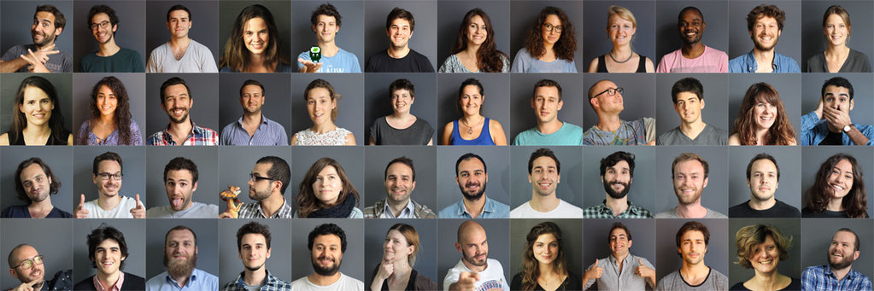


Slide 2








Slide 4


Bring technical skills
to creative people

Slide 5
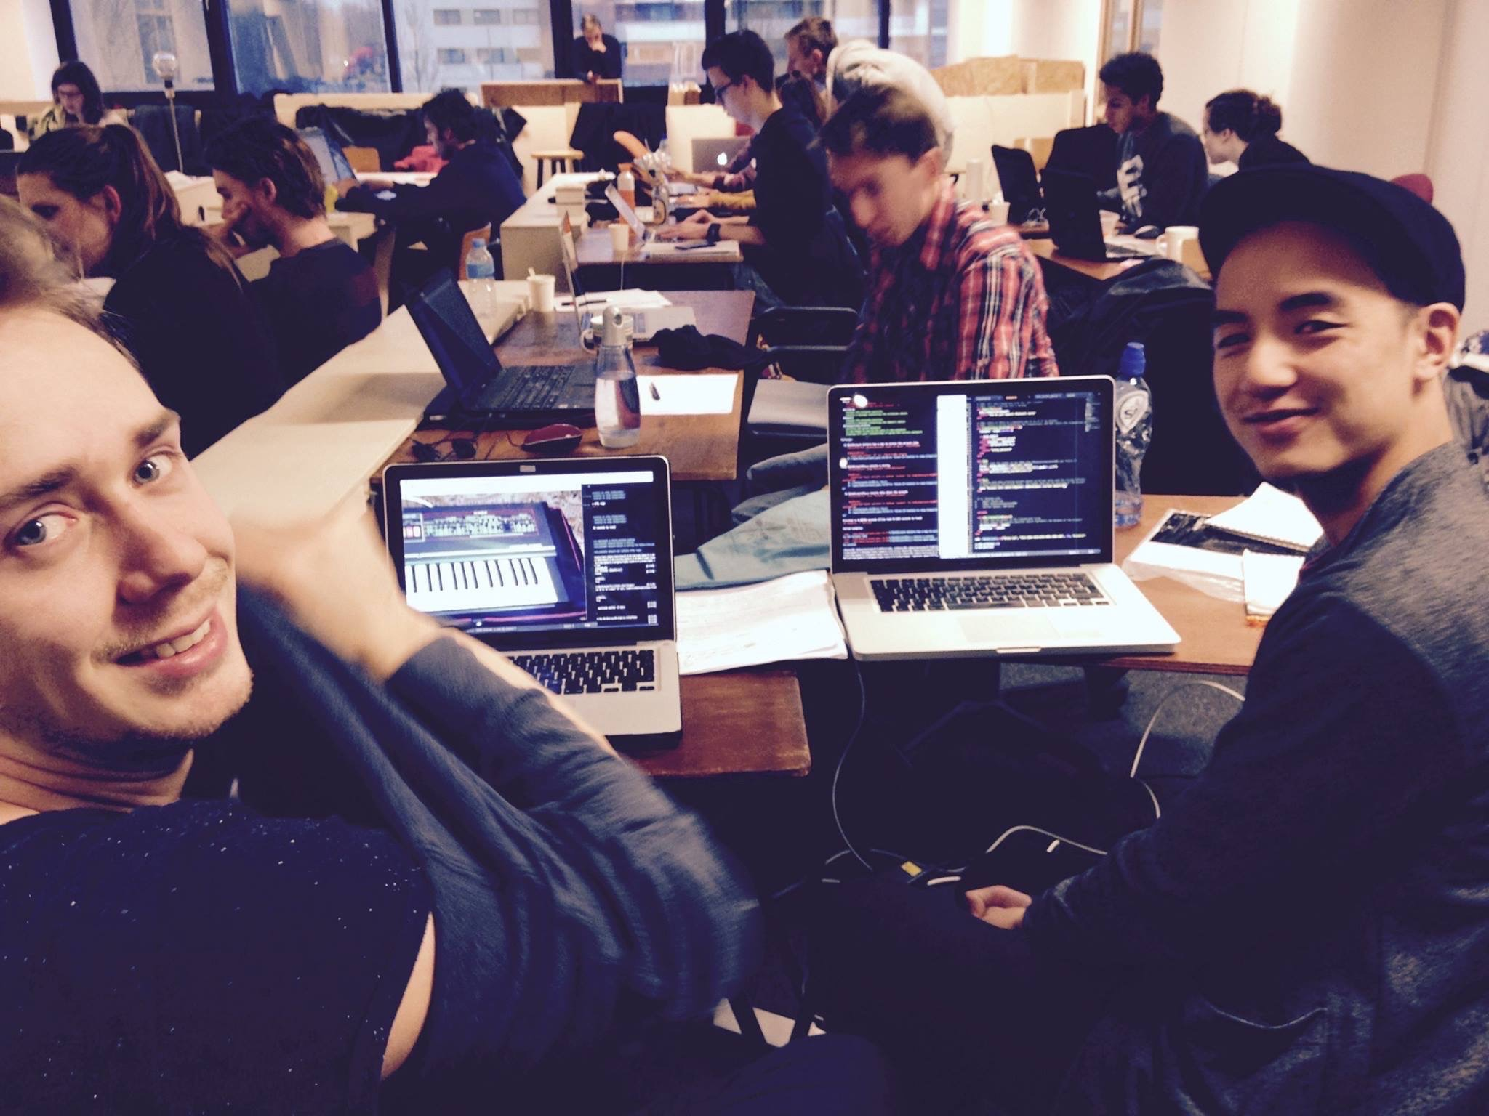

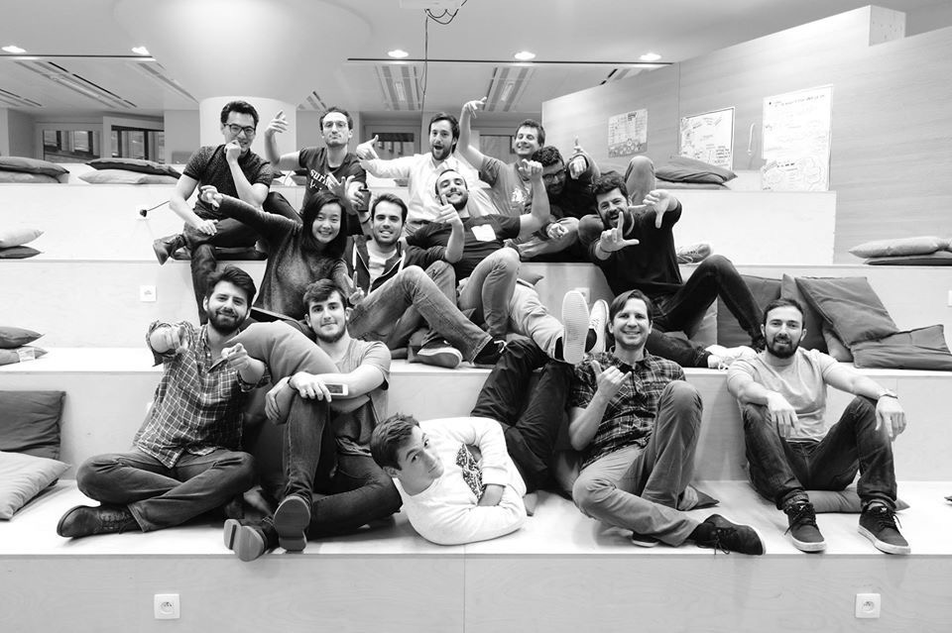
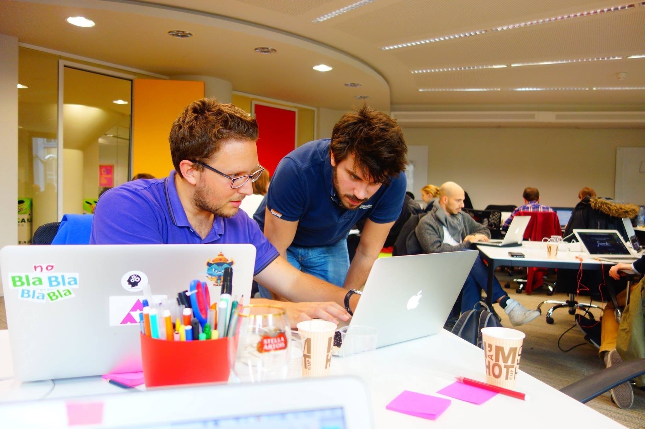
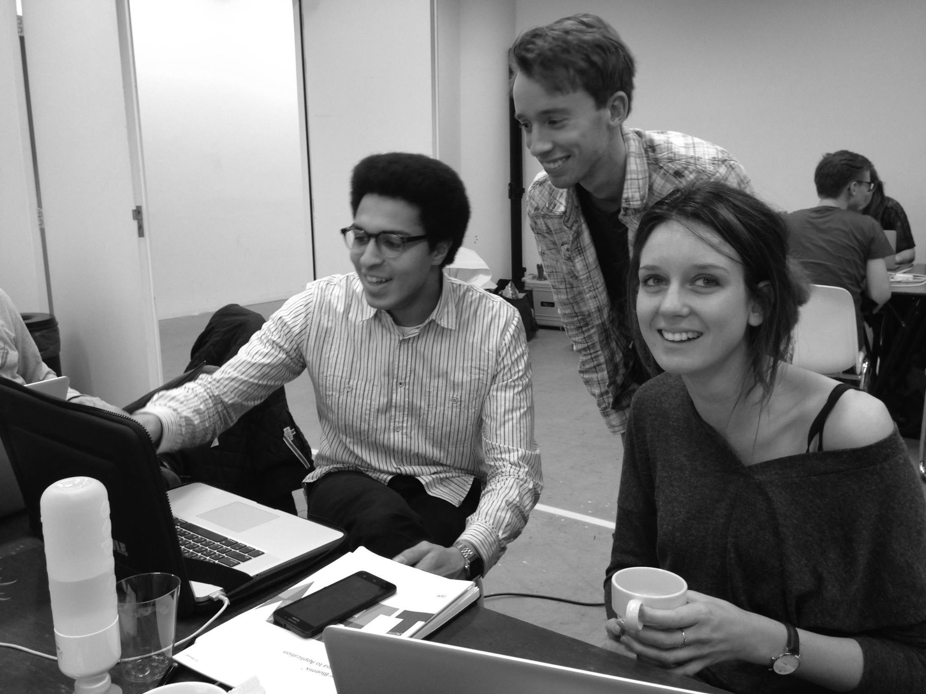
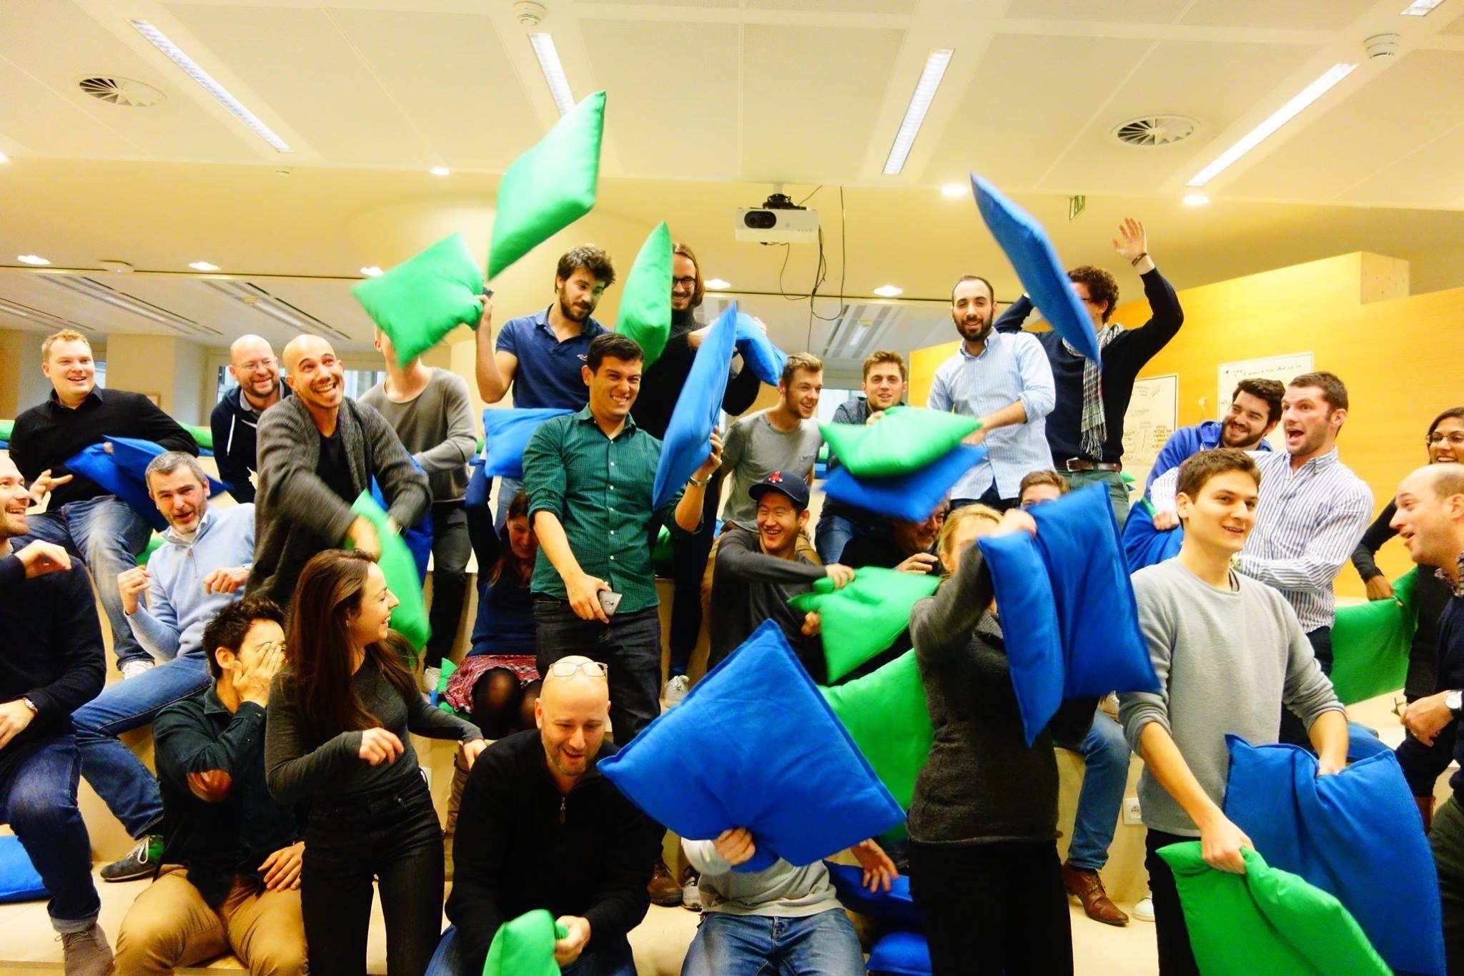
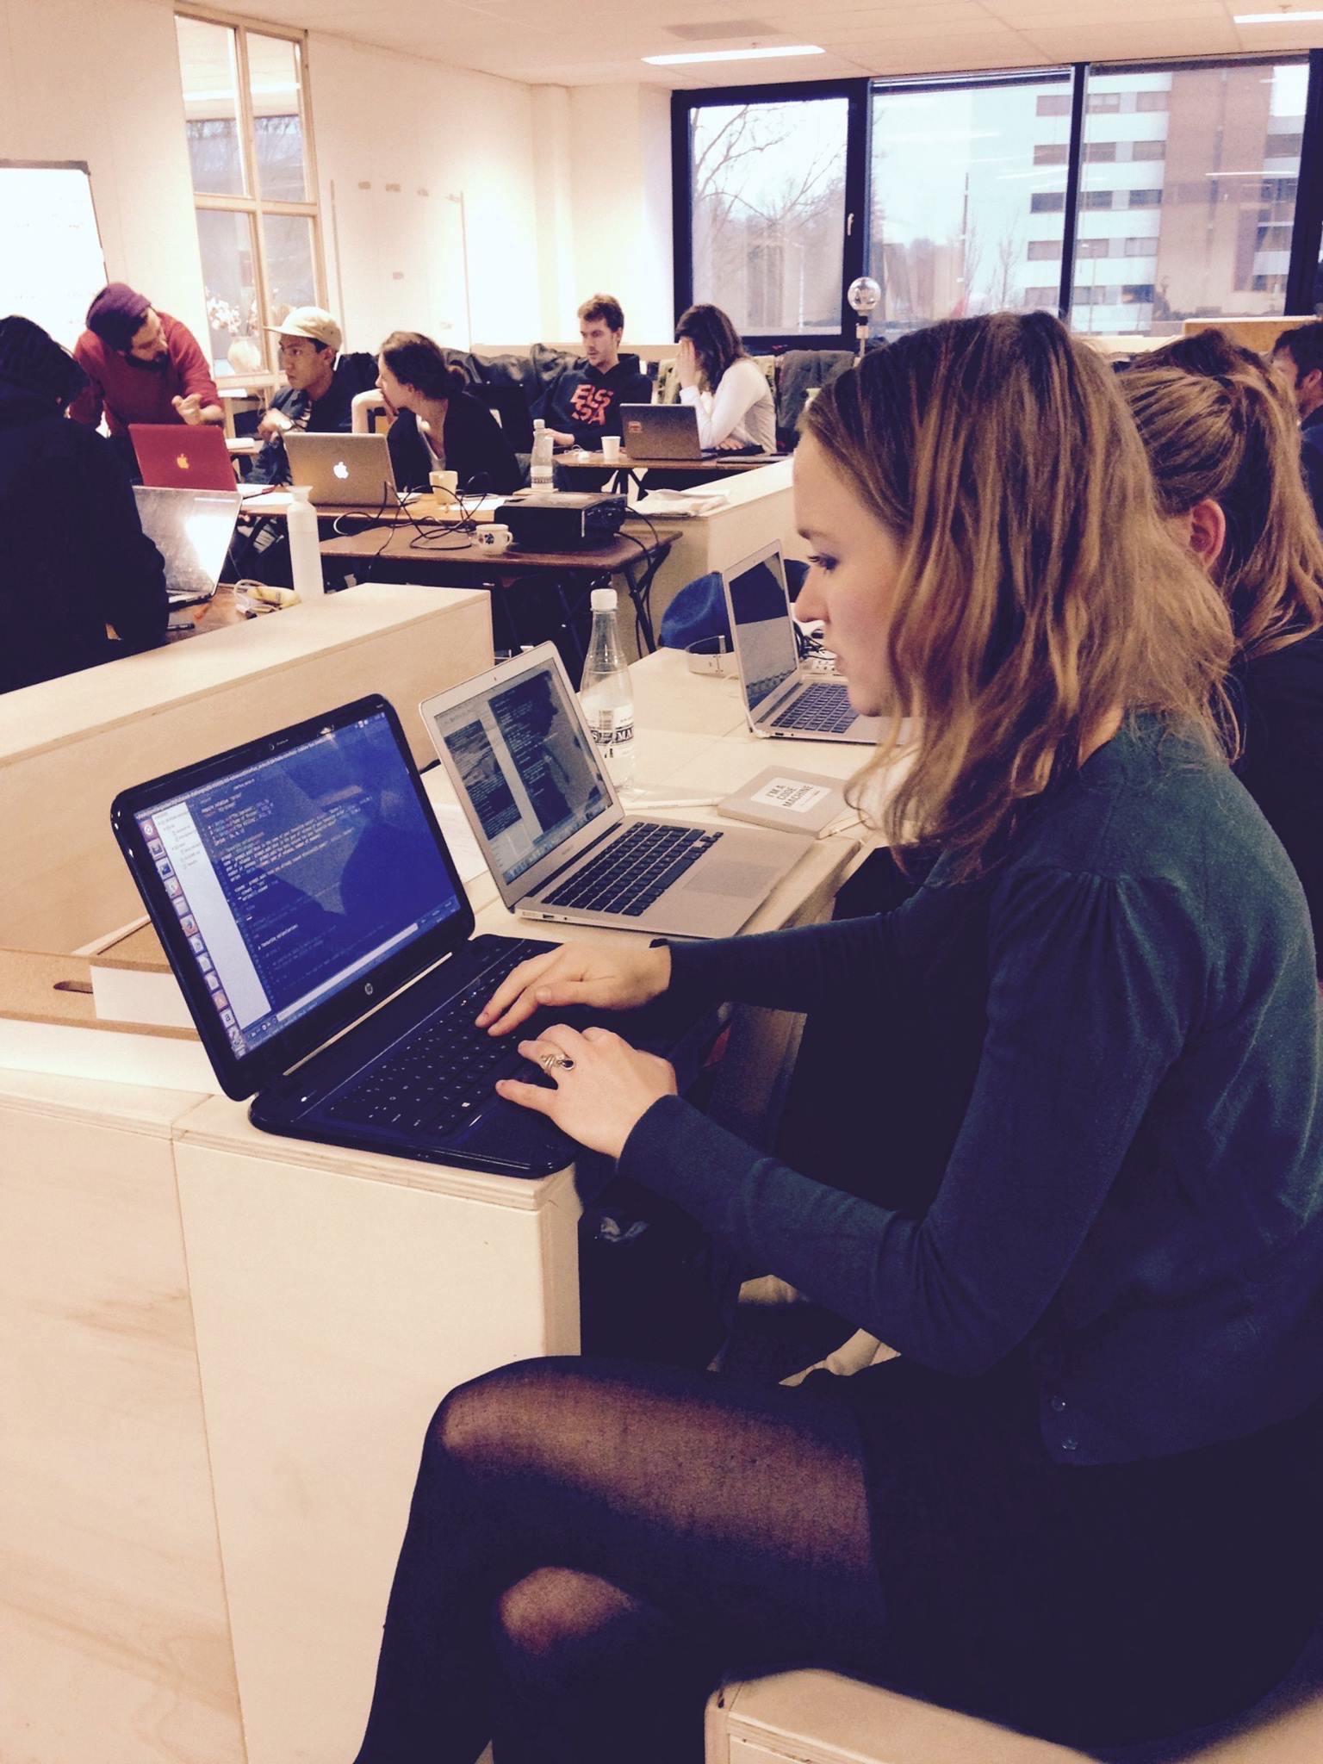



Slide 6
Community Workshops
Tue 08 Nov
API for Beginners
The 2-hour Landing Page
Javascript class for Beginners
CSS Components Design
WeChat API Hands-on
Thu 10 Nov
Sat 26 Nov
Tue 29 Nov
Sat 03 Dec
Tue 06 Dec
Technical workflow in Startups
Git & GitHub for Beginners
Product specs 101
Launch your product: Tools & Metrics
Sketch UI Design Crash Course
Thu 08 Dec
Tue 13 Dec
Tue 10 Jan
Tue 17 Jan

Slide 7
CSS components
design

Slide 8
Components 101
Easy CSS tricks
Advanced patterns

Slide 9
UI components
==
Elementary blocks
of app design

Slide 10
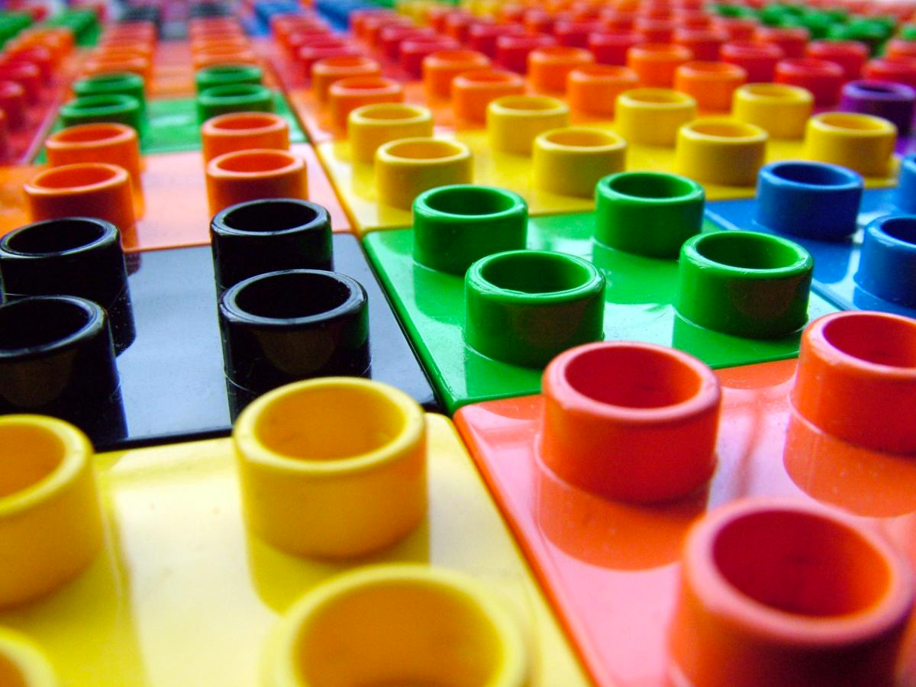
5 to 10 components to master
90% of your app design

Slide 11
Which UI components
do you know?

Slide 12


Images
Avatar
Thumbnail

Slide 13
Buttons
Start now
Twitter
SIGN UP
Google
Write a story
Medium
Free trial
treehouse

Slide 14
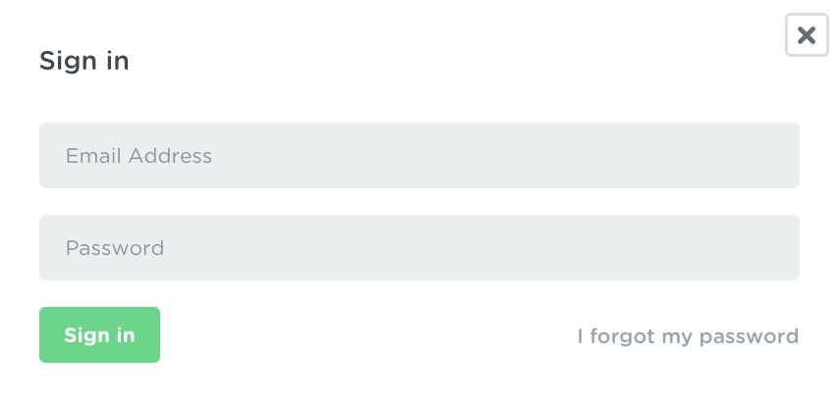
Forms
Login form (treehouse)
Search form (airbnb)

Slide 15
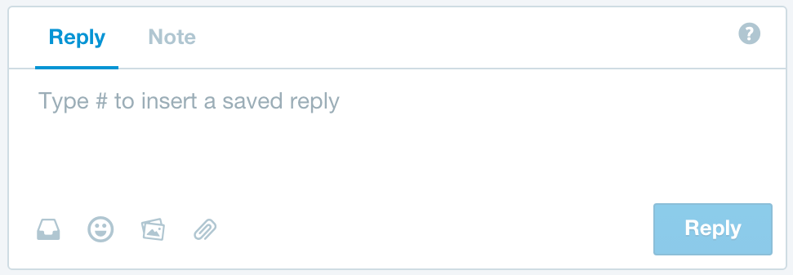
Forms
Chatbox form (Intercom)

Slide 16
Tabs / Navs
Medium
ProductHunt
Twitter

Slide 17
Navbars
Medium
Twitter
Github

Slide 18
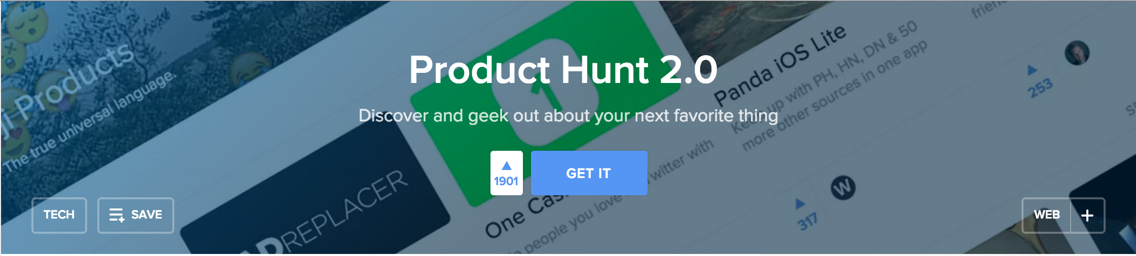
Banners

Slide 19
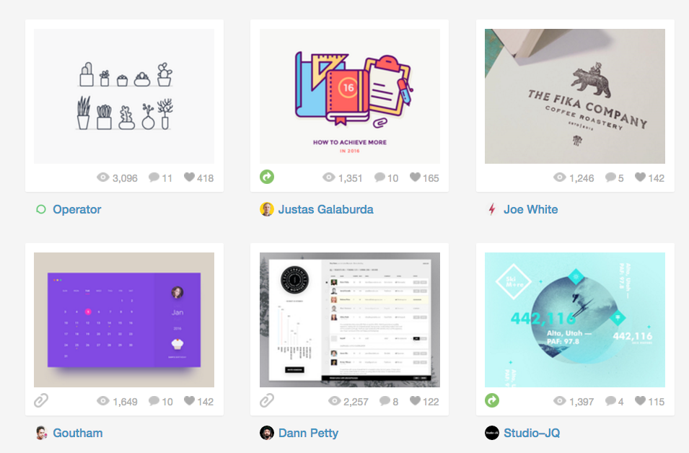
Cards

Slide 20
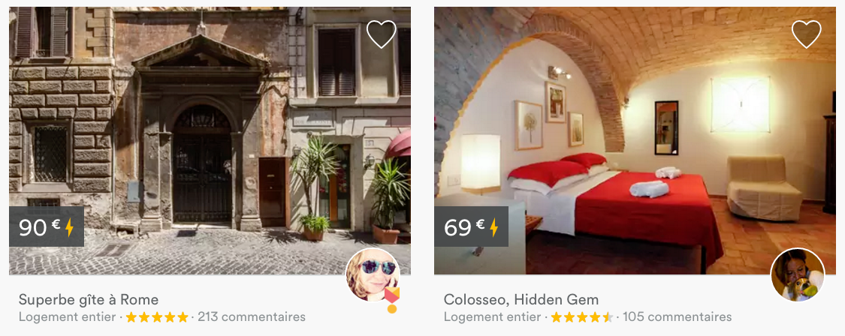
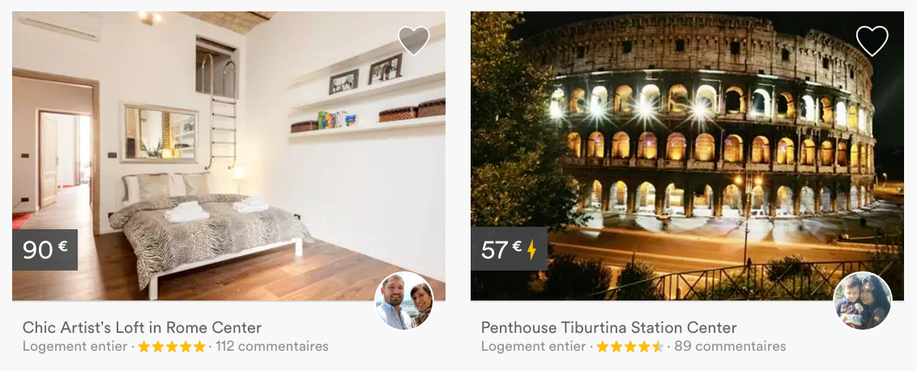
Cards

Slide 21
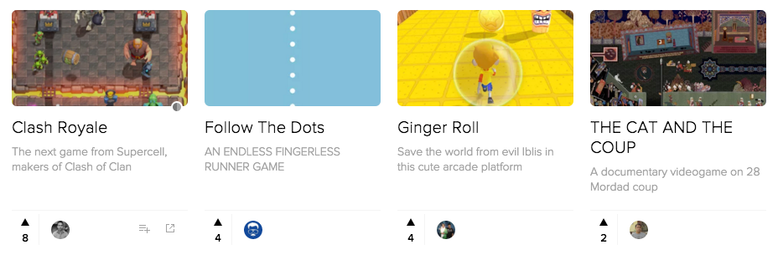
Cards

Slide 22
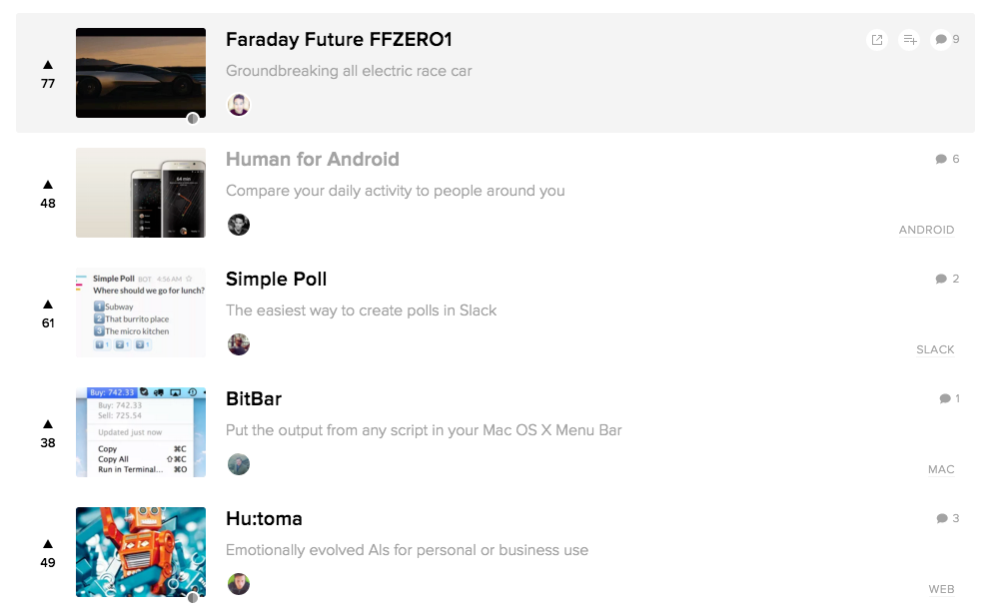
Lists

Slide 23
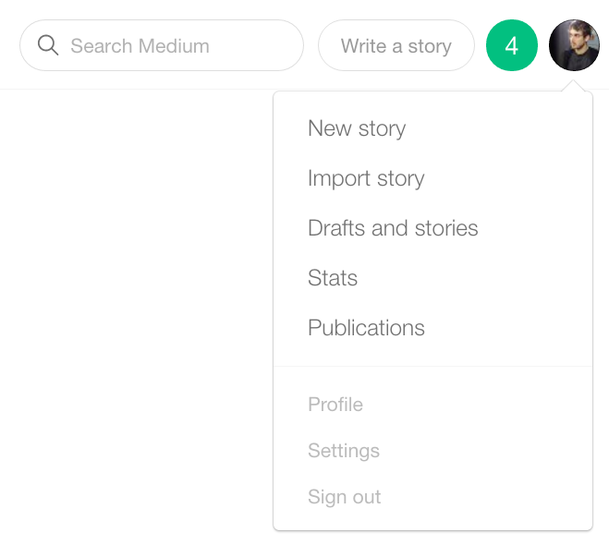
Dropdown

Slide 24



Setup

Slide 25
Starting Boilerplate
Download ZIP or clone
https://github.com/Papillard/UI-sprint

Slide 26
Easy CSS examples
Let’s code together
Avatars
Buttons
Dropdowns

Slide 27
CSS advanced
patterns

Slide 28
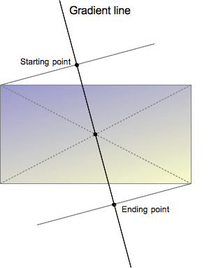
Gradient filter CSS

Slide 29
Gradient filter CSS
background: linear-gradient(angle,
start_color start_point,
end_color end_point),
url('background.jpg');
background: linear-gradient(135deg,
yellow 0%,
green 50%),
url('background.jpg');

Slide 30

Relative position
Offset from initial position
A way to pin an element
Let’s offset logo on https://www.lewagon.com/

Slide 31
Absolute position
Offset from 1st positioned parent
If no pinned parent => body

Slide 32
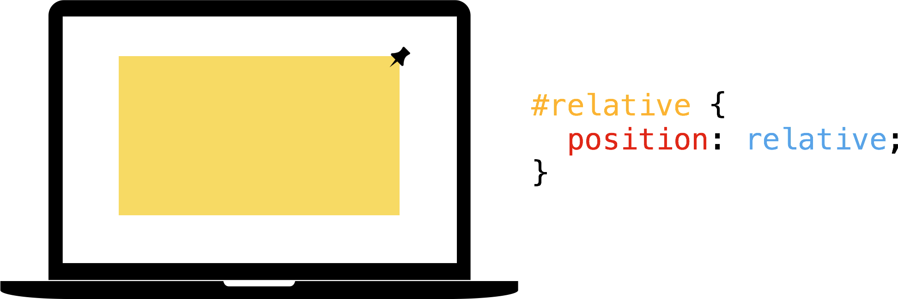
Relative / Absolute pattern

Slide 33
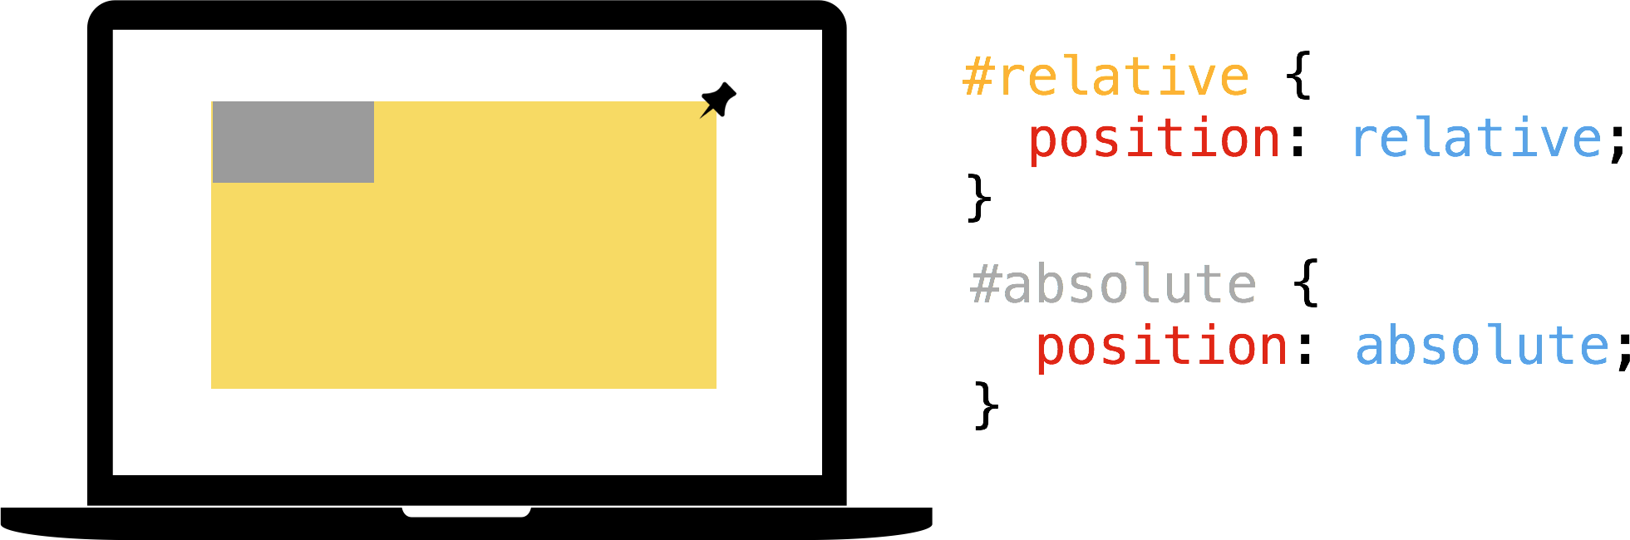
Relative / Absolute pattern

Slide 34
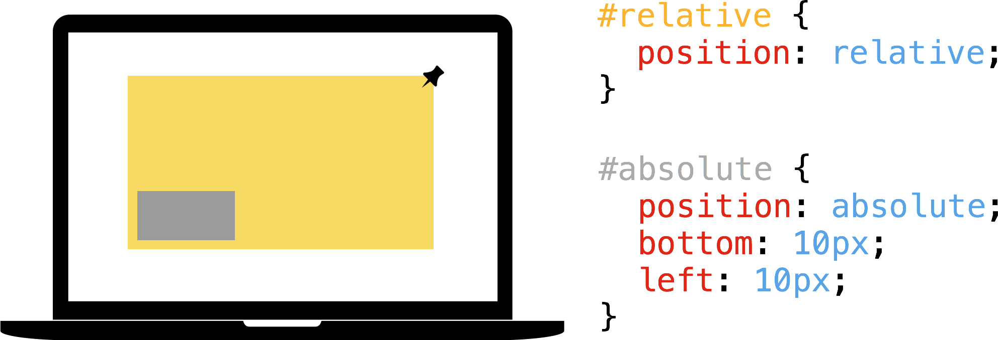
Relative / Absolute pattern

Slide 35
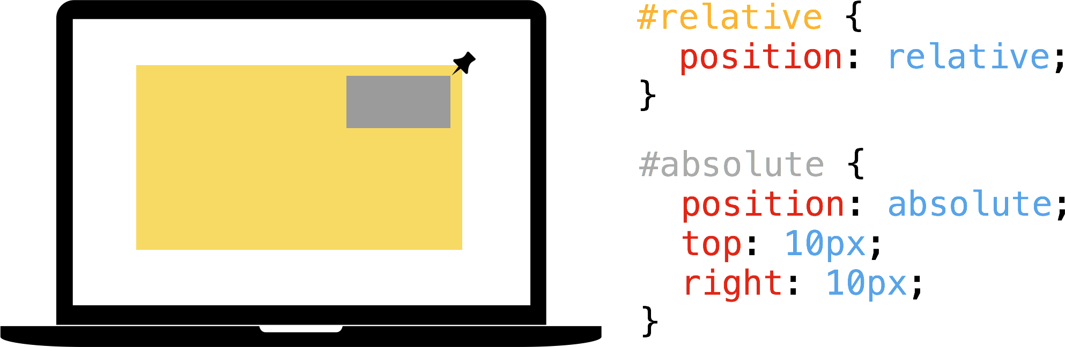
Relative / Absolute pattern

Slide 36
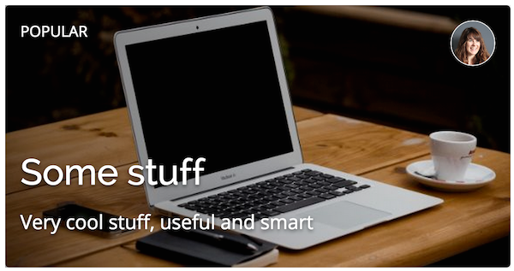
Relative / Absolute pattern
card design

Slide 37

Relative / Absolute pattern
badge design

Slide 38
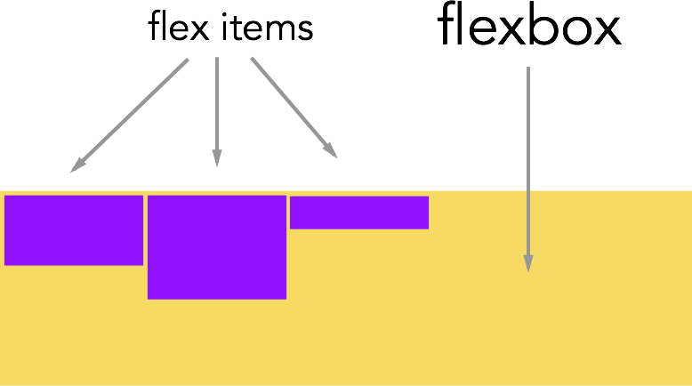
Flexbox - Vocabulary

Slide 39
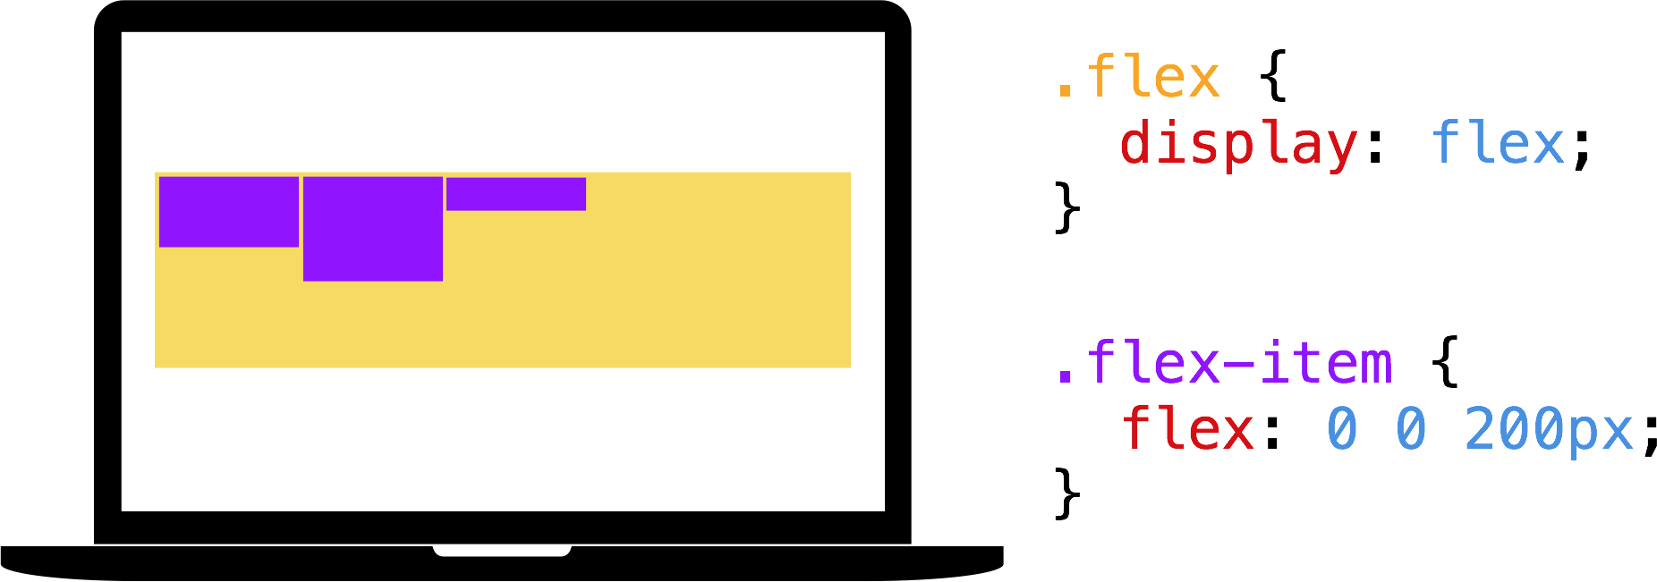
Flexbox

Slide 40
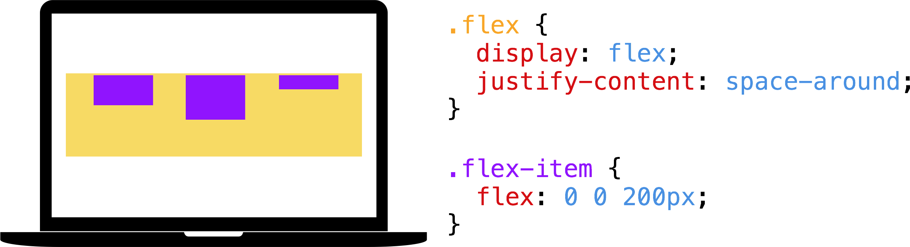
Flexbox

Slide 41
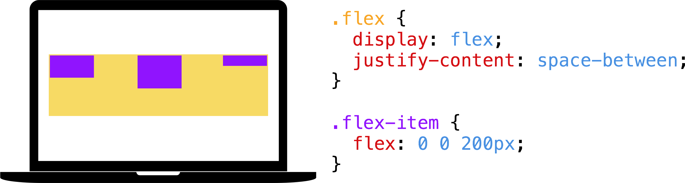
Flexbox

Slide 42
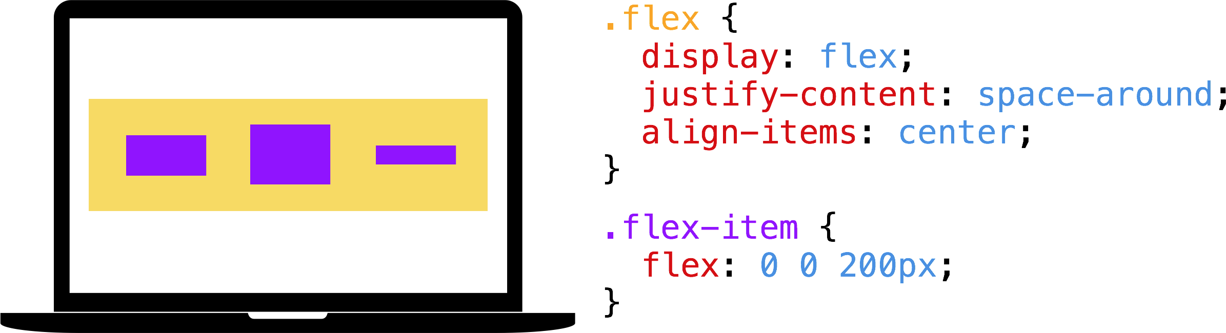
Flexbox

Slide 43
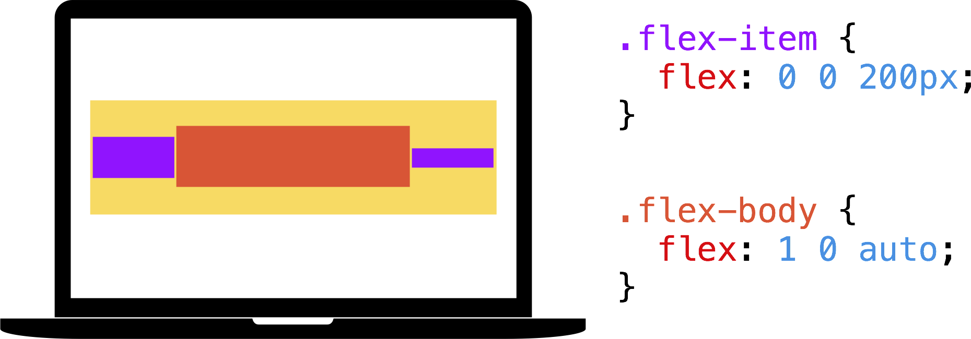
Flexbox

Slide 44
Flexbox example
Banner design (centering on horizontal & vertical axis)

Slide 45
Flexbox example
tab design

Slide 46
Flexbox example
list item design

Slide 47

Small gift
lewagon.github.io/ui-components/
Go further
http://lewagon.com/shanghai

Slide 48
Thank you!

